Slide 1


JET: Type-Driven Web Framework for Guaranteed Consistency and Fine-Grained Rendering
Jiahao Zhang, EECS Peking Univ.
Advisor: Keith Winstein
August 2025

Slide 2

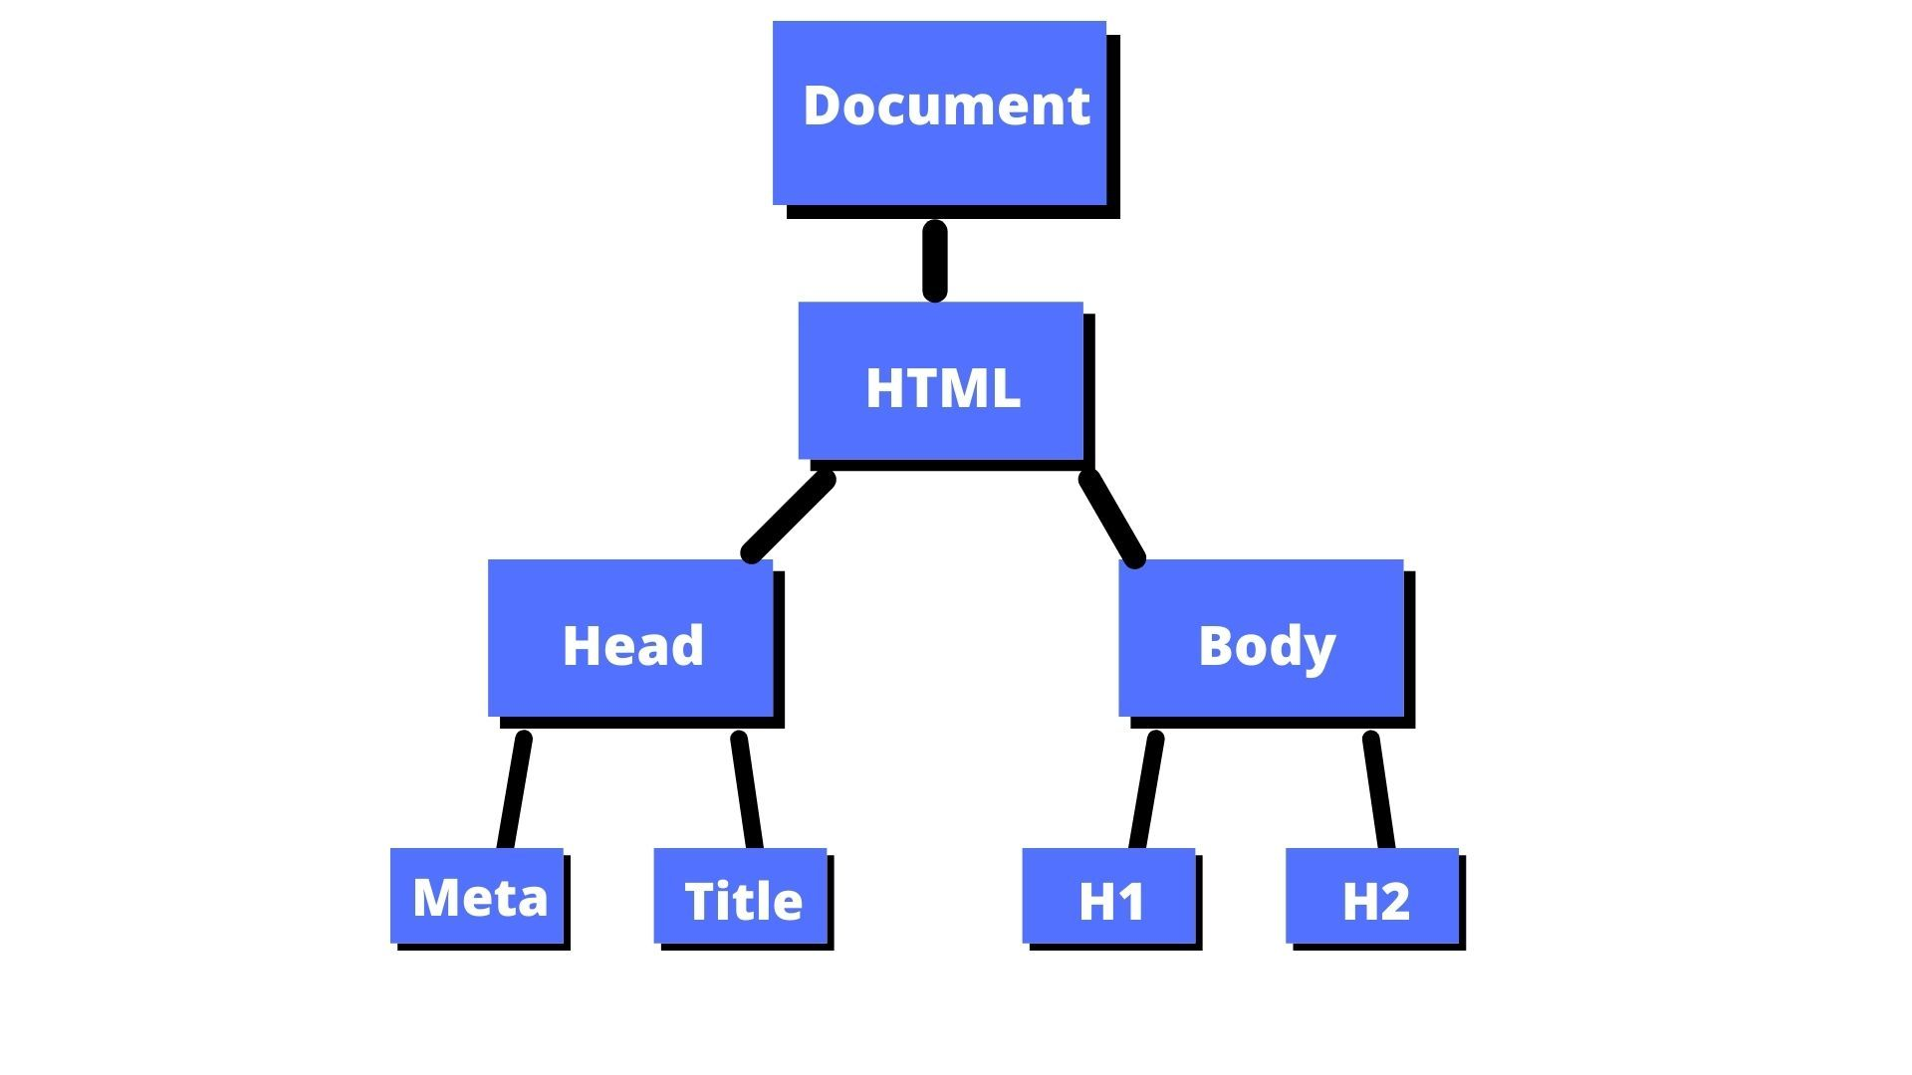

Background about Web Programming
browser
Document Object Model(DOM)
Rendered Website

Slide 3
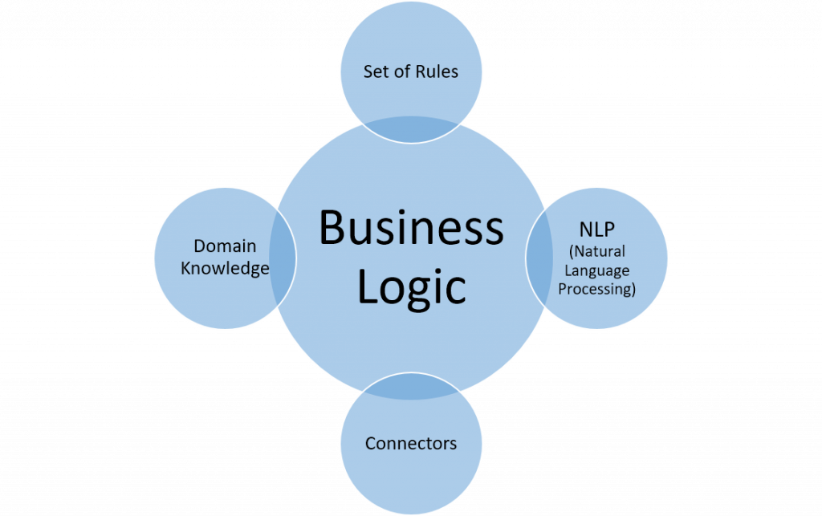
Motivation
Problem:
Inconsistency in
web programming
DOM
State
(browser & client’s view)
Program
State
(programmer’s view)
≠
JET’s Approach:
Type System

Slide 4
Problem: Inconsistence
DOM State
(browser & client’s view)
Program State
(programmer’s view)
Button: Peak Load Mode
Execute: Peak Load Mode
Button: Shutdown All Servers
Execute: Shutdown All Servers

Slide 5
Problem: Inconsistence
DOM State
(browser & client’s view)
Program State
(programmer’s view)
Button: Peak Load Mode
Execute: Peak Load Mode
Button: Shutdown All Servers
Execute: Shutdown All Servers
Button: Reduce 50% Capacity
Execute: Reduce 50% Capacity

Slide 6
Problem: Inconsistence
DOM State
(browser & client’s view)
Program State
(programmer’s view)
Button: Peak Load Mode
Execute: Peak Load Mode
Button: Reduce 50% Capacity
Execute: Shutdown All Servers
Button: Shutdown All Servers
Execute: Reduce 50% Capacity

Slide 7
Problem: Inconsistence
DOM State
(browser & client’s view)
Program State
(programmer’s view)
Button: Peak Load Mode
Execute: Peak Load Mode
Button: Reduce 50% Capacity
Execute: Shutdown All Servers
Button: Shutdown All Servers
Execute: Reduce 50% Capacity

Slide 8
Problem: Inconsistence
DOM State
(browser & client’s view)
Program State
(programmer’s view)
Button: Peak Load Mode
Execute: Peak Load Mode
Button: Reduce 50% Capacity
Execute: Shutdown All Servers
Button: Shutdown All Servers
Execute: Reduce 50% Capacity

Slide 9
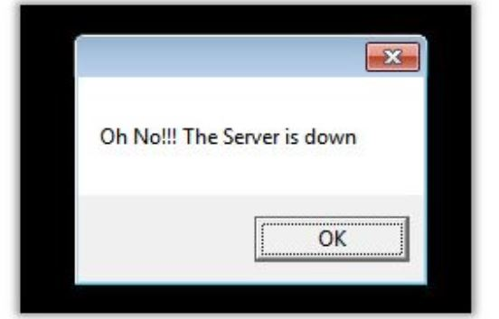
Problem: Inconsistence

Slide 10
JET: Type Compile-time check for Consistency
DOM State
(browser & client’s view)
Program State
(programmer’s view)
Button: Peak Load Mode
Execute: Peak Load Mode
Button: Shutdown All Servers
Execute: Shutdown All Servers

Slide 11

JET: Type Compile-time check for Consistency
DOM State
(browser & client’s view)
Program State
(programmer’s view)
Type: Component1
Button: Peak Load Mode
Execute: Peak Load Mode
Type: Component2
Button: Shutdown All Servers
Execute: Shutdown All Servers

Slide 12
JET: Type Compile-time check for Consistency
DOM State
(browser & client’s view)
Program State
(programmer’s view)
Type: Component1
Button: Peak Load Mode
Execute: Peak Load Mode
Type: Component2
Button: Shutdown All Servers
Execute: Shutdown All Servers
NO!
Button: Reduce 50% Capacity
Compiler

Slide 13
JET: Type Runtime Auditing for consistence
DOM State
(browser & client’s view)
Program State
(programmer’s view)
Type: Component1
Button: Peak Load Mode
Execute: Peak Load Mode
Type: Component2
Button: Shutdown All Servers
Execute: Shutdown All Servers

Slide 14
JET: Type Runtime Auditing for consistence
DOM State
(browser & client’s view)
Program State
(programmer’s view)
Type: Component1
Button: Peak Load Mode
Execute: Peak Load Mode
Type: Component2
Button: Shutdown All Servers
Execute: Shutdown All Servers
Running

Slide 15
JET: Type Runtime Auditing for consistence
DOM State
(browser & client’s view)
Program State
(programmer’s view)
Type: Component1
Button: Peak Load Mode
Audit
Execute: Peak Load Mode
Type: Component2
Button: Shutdown All Servers
Audit
Execute: Shutdown All Servers
Running

Slide 16

JET: Type Runtime Auditing for consistence
DOM State
(browser & client’s view)
Program State
(programmer’s view)
Type: Component1
Button: Peak Load Mode
Audit
Execute: Peak Load Mode
Type: Component2
Button: Shutdown All Servers
Audit
Execute: Shutdown All Servers
I did this bad thing.
Running

Slide 17
JET: Type Runtime Auditing for consistence
DOM State
(browser & client’s view)
Program State
(programmer’s view)
Type: Component1
Button: Peak Load Mode
Audit
Execute: Peak Load Mode
Type: Component2
Button: Shutdown All Servers
Audit
Execute: Shutdown All Servers
Running

Slide 18
JET: Type Runtime Auditing for consistence
DOM State
(browser & client’s view)
Program State
(programmer’s view)
Type: Component1
Button: Peak Load Mode
Execute: Peak Load Mode
Audit: Error
Type: Component2
Button: Shutdown All Servers
Audit
Execute: Shutdown All Servers
Running

Slide 19
Thank You
JET Poster: #3

